Slide 1


DEPARTMENT OF CSE
AI-Powered Team Formation Tool
Team Member 1 :DEEPASHRI MURALI(240701100)
Team Member 2 :KM BUSHRA BANU(240701084)

Slide 2
ABSTRACT
The AI-Powered Team Formation Tool is an intelligent application designed to automatically create fair, balanced, and skill-diverse teams based on individual skills, attendance, portfolio submission, and leadership experience. It uses Artificial Intelligence techniques such as a Forward-Chaining Rule Engine and Constraint Satisfaction Problem (CSP) solving to determine role eligibility and generate suitable teams.
The system allows users to specify team sizes, required skills, eligible roles, and team member constraints. A backtracking algorithm finds team combinations that satisfy these requirements while maintaining fairness and skill diversity. It also provides fairness metrics and identifies unmet constraints when a perfect team arrangement is not possible. Additionally, the system suggests suitable campus meeting points for the formed teams.
The application is developed using Python and Streamlit, providing a simple and interactive user interface. This tool helps reduce manual effort, improve team organization, and support efficient collaboration in academic and project-based environments.

Slide 3
PROBLEM STATEMENT
Forming balanced and effective teams manually is a challenging task, as it is difficult to evaluate individual skills, attendance, portfolio contributions, and leadership experience fairly. Traditional team formation methods may result in uneven skill distribution, unbalanced workloads, and unsuitable role assignments.
Therefore, an AI-powered team formation tool is needed to automatically organize individuals into balanced teams based on predefined requirements and constraints. The system aims to improve fairness, maximize skill diversity, assign suitable roles, and reduce the time and effort required for team formation.

Slide 4
LITERATURE SURVEY
S. No. | Author(s) & Year | Research Paper Title | Methodology | Limitation
1 | J. Wang et al. (2016) | USTF: A Unified System of Team Formation | Compares team formation algorithms and evaluates their performance using real-world datasets. | Focuses mainly on team formation in social networks and algorithm benchmarking.
2 | Robert Bredereck et al. (2018) | Parameterized Complexity of Team Formation in Social Networks | Studies the computational complexity of forming skill-based teams while minimizing communication costs. | Finding suitable teams can become computationally challenging as constraints increase.

Slide 5
LITERATURE SURVEY
S. No. | Author(s) & Year | Research Paper Title | Methodology | Limitation
3 | Kalyani Selvarajah et al. (2021) | A Unified Framework for Effective Team Formation in Social Networks | Uses a multi-objective approach considering expertise, communication costs, trust, and proximity. | The framework involves multiple objectives and may require complex optimization.
4 | Diego Gómez-Zará et al. (2022) | In Search of Diverse and Connected Teams: A Computational Approach to Assemble Diverse Teams Based on Members' Social Network | Uses NSGA-II, a multi-objective genetic algorithm, to form diverse teams while considering existing social connections. | Requires additional information about members' characteristics and social connections.

Slide 6
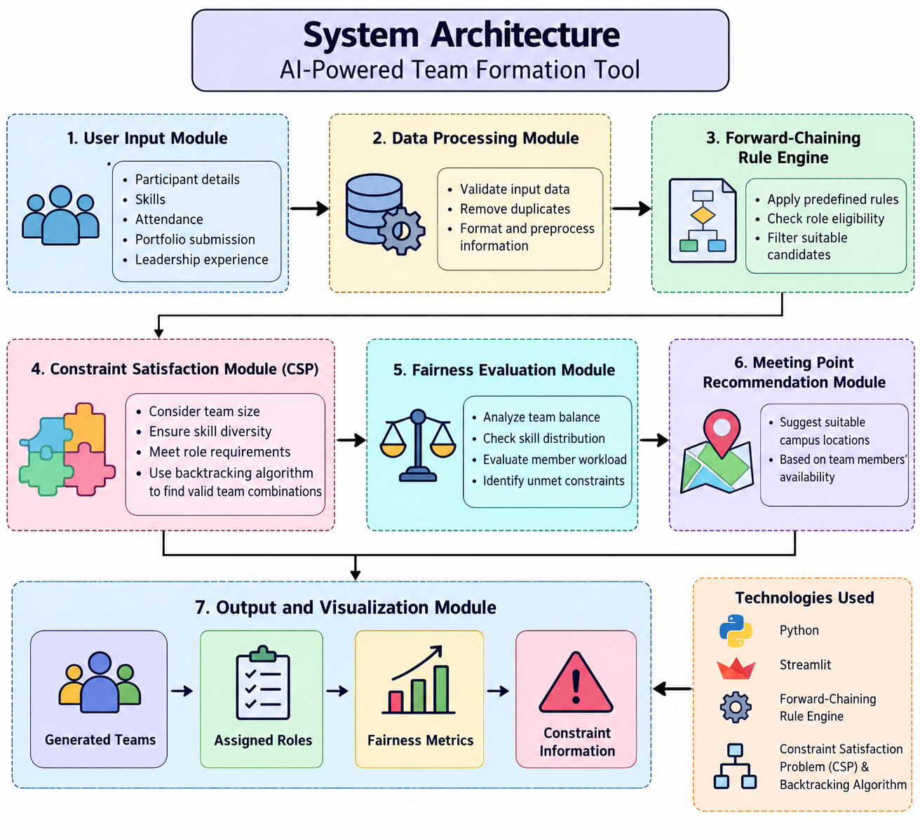
ARCHITECTURE FLOW DIAGRAM

Slide 7
PROPOSED SYSTEM
The proposed system automatically forms balanced and effective teams using an AI-based, rule-driven approach. It considers participants’ skills, attendance, portfolio submission, and leadership experience to create suitable teams.
The system uses a Forward-Chaining Rule Engine to identify eligible participants and a Constraint Satisfaction Problem (CSP) with backtracking to generate teams that satisfy predefined conditions. A fairness evaluation module checks skill distribution, role allocation, and team balance. It also recommends suitable campus meeting points for the formed teams.

Slide 8
IMPLEMETATION DETAILS
1. Frontend
Technology: Streamlit
Provides a user-friendly interface to enter participant details and view generated teams.
Displays team members, assigned roles, and fairness metrics.
2. Backend
Programming Language: Python
Processes participant data and manages team formation.
Implements rule-based decision-making and team allocation logic.
3. Database
Technology: SQLite
Stores participant details, skills, attendance, portfolio status, leadership experience, and generated team information.

Slide 9
IMPLEMETATION DETAILS
4. AI and Algorithms
Forward-Chaining Rule Engine: Identifies eligible participants and suitable roles based on predefined rules.
Constraint Satisfaction Problem (CSP): Ensures teams meet specified requirements.
Backtracking Algorithm: Searches for valid team combinations when constraints are not satisfied.
Key Features:
Automatic team formation.
Balanced distribution of skills among teams.
Role assignment based on participants’ abilities.
Fairness evaluation and constraint checking.
Identification of unmet constraints.
Campus meeting-point recommendations.

Slide 10
RESULTS
The AI-Powered Team Formation Tool aims to automate the process of forming balanced and effective teams based on participants’ skills, attendance, portfolio submission, and leadership experience. The system uses rule-based techniques and constraint satisfaction algorithms to distribute members, assign suitable roles, and evaluate team fairness. It also identifies unmet constraints and recommends suitable campus meeting points. The proposed system helps reduce manual effort, improve skill distribution, and support fair and efficient team formation through a user-friendly interface.
Outcome
The proposed system aims to reduce manual effort, improve team balance, and support fair and efficient team formation.

Slide 11
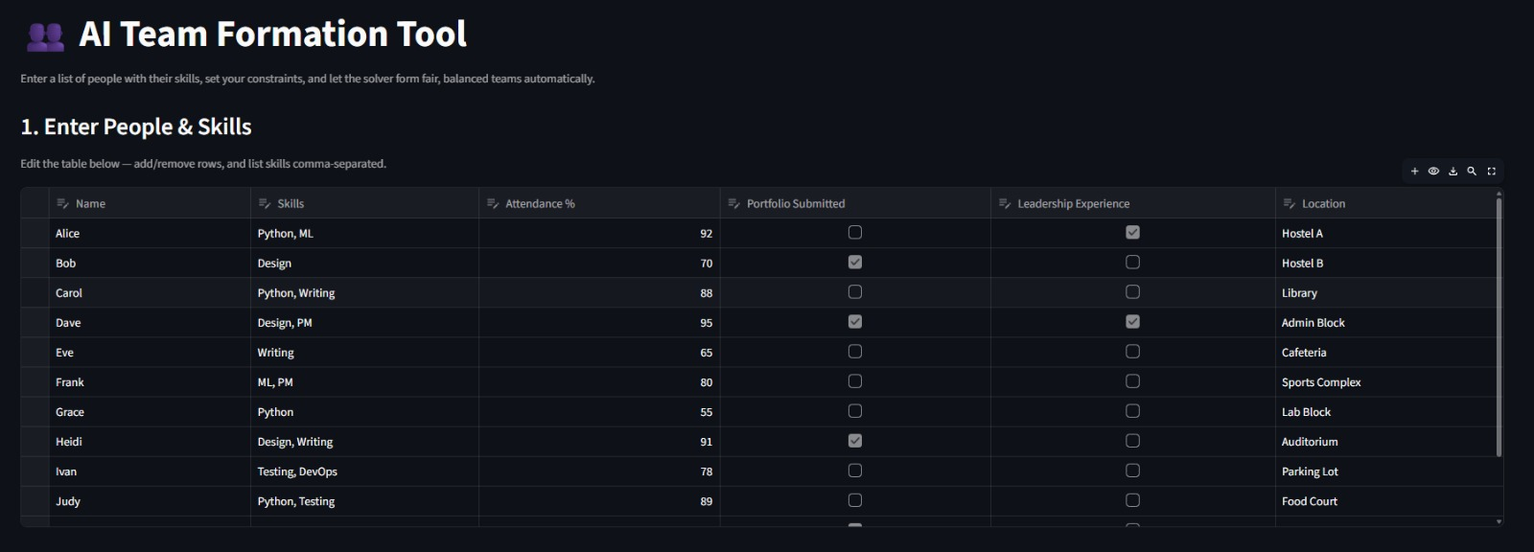

Slide 12
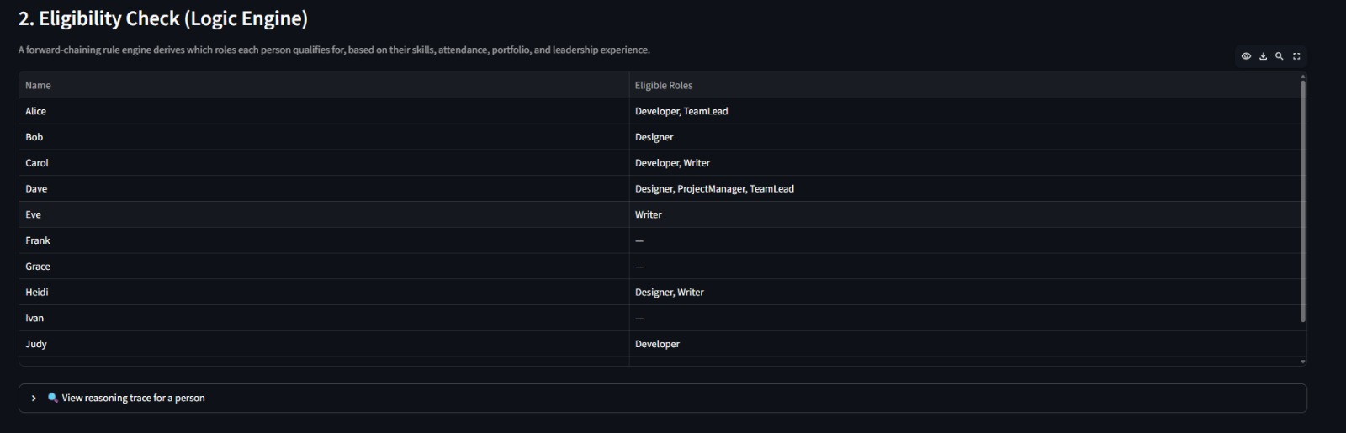

Slide 13
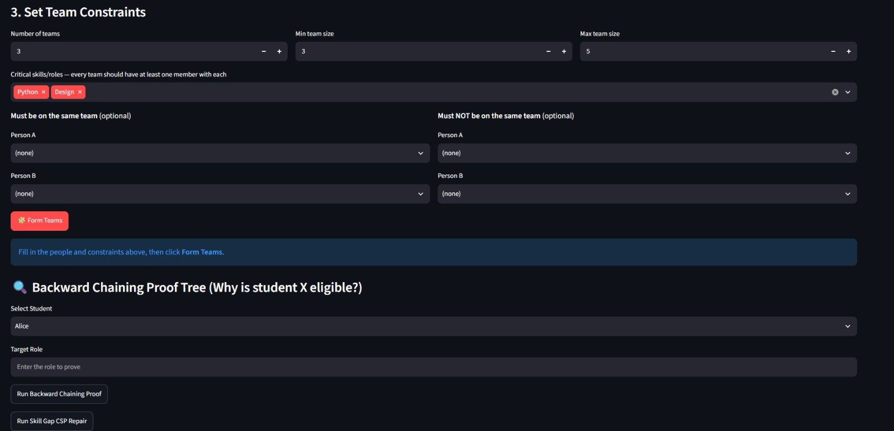

Slide 14
FUTURE ENHANCEMENT
Machine Learning Integration: Predict team performance based on members’ skills and previous project experiences.
Advanced Skill Assessment: Evaluate participants’ technical and soft skills for better team formation.
Real-Time Availability: Track members’ availability to form suitable teams.
Automatic Role Assignment: Assign roles based on individual strengths and expertise.
Meeting Schedule Recommendation: Suggest suitable meeting times and campus locations.
Cloud-Based Deployment: Make the system accessible from anywhere.
Mobile Application: Develop a mobile app for easier access.
College Management Integration: Connect with college systems to collect participant information automatically.

Slide 15
REFERENCE
Wang, J. et al. (2016), USTF: A Unified System of Team Formation, IEEE.
https://ieeexplore.ieee.org/document/7445184
Bredereck, R. et al. (2018), Parameterized Complexity of Team Formation in Social Networks, Theoretical Computer Science.
https://doi.org/10.1016/j.tcs.2017.05.024
Selvarajah, K. et al. (2021), A Unified Framework for Effective Team Formation in Social Networks, Expert Systems with Applications.
https://doi.org/10.1016/j.eswa.2021.114886
Gómez-Zará, D. et al. (2022), In Search of Diverse and Connected Teams: A Computational Approach to Assemble Diverse Teams Based on Members' Social Networks, PLOS ONE.
https://doi.org/10.1371/journal.pone.0276061
Python Documentation
Streamlit Documentation
SQLite Documentation

Slide 16
THANK YOU

